Slide 1
Burnout & Overwhelm Support Bot Presentation
Jerry Wang

Slide 2

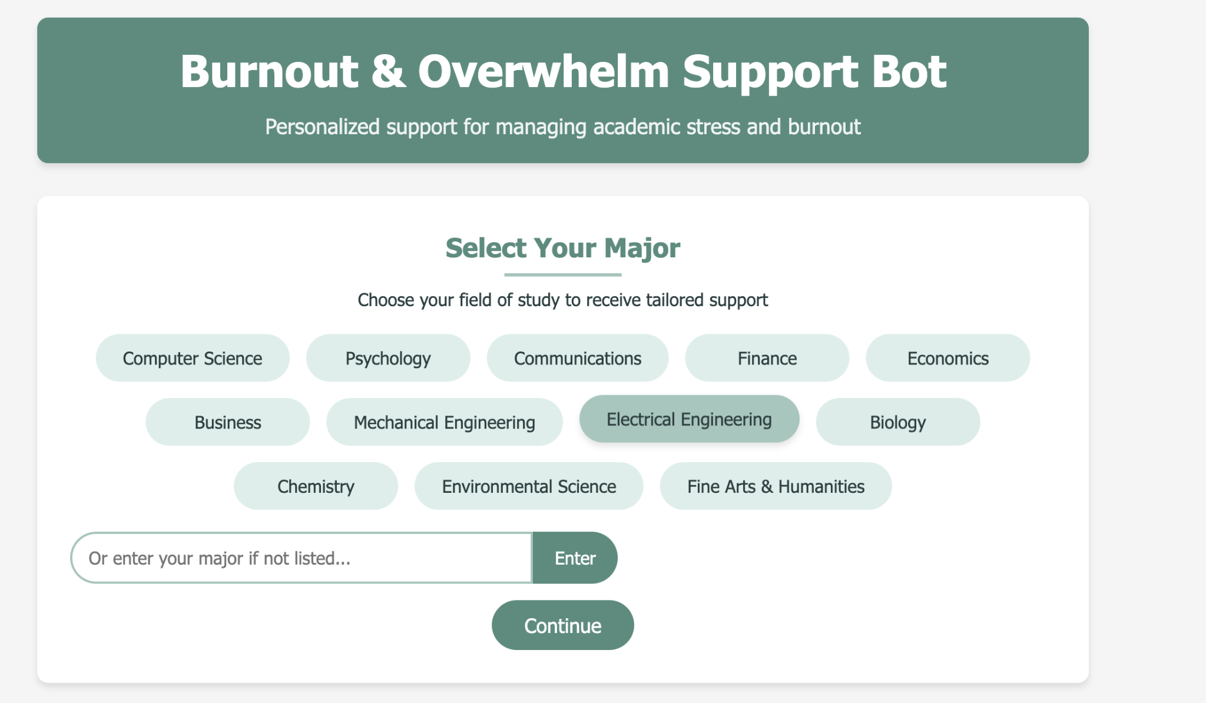
Ideas Behind the Application
A web-based application to help college students manage academic stress and burnout.
Provide tailored advice utilizing customized prompt based on students’ major/year and powerful generative AI model.
Personalized guidance to combat academic stress the mental health challenges faced by students
Helps manage overwhelming workloads.
Get more specific help through conversation

Slide 3

Why This Matters
Target Users: College students facing academic pressure or career-related worries
Offer immediate, empathetic advice during stressful moments.
Reduces barriers to mental health support by giving easy, anonymous access to helpful tips.
Encourages proactive self-care, relief and better time management.

Slide 4

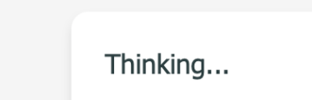
The Generative Model
Model Choice: Uses generative model from api call: gemini-2.0-flash-thinking-exp
Implementation:
A Flask backend routes user inputs (concerns) and customized prompts for major, year to the model.
The model then responds with markdown-formatted text containing personalized guidance.
Responses are converted to HTML before rendering in the browser.
Why This Model?
Strong natural language capabilities to handle varied customized prompts for students with different majors and different school years.
Provide fast, adaptable, and context-specific responses.

Slide 5
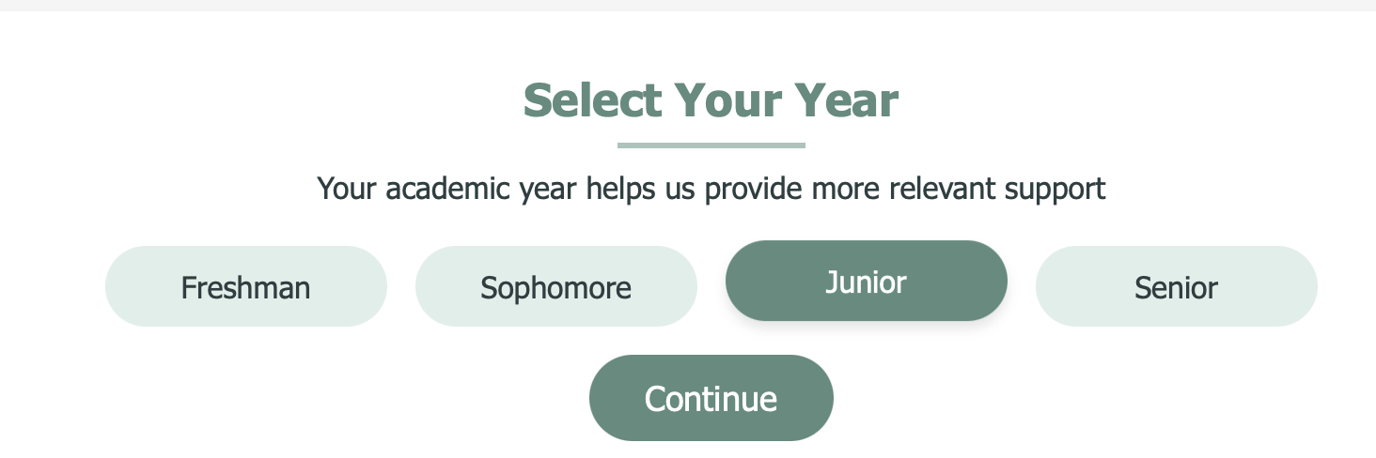
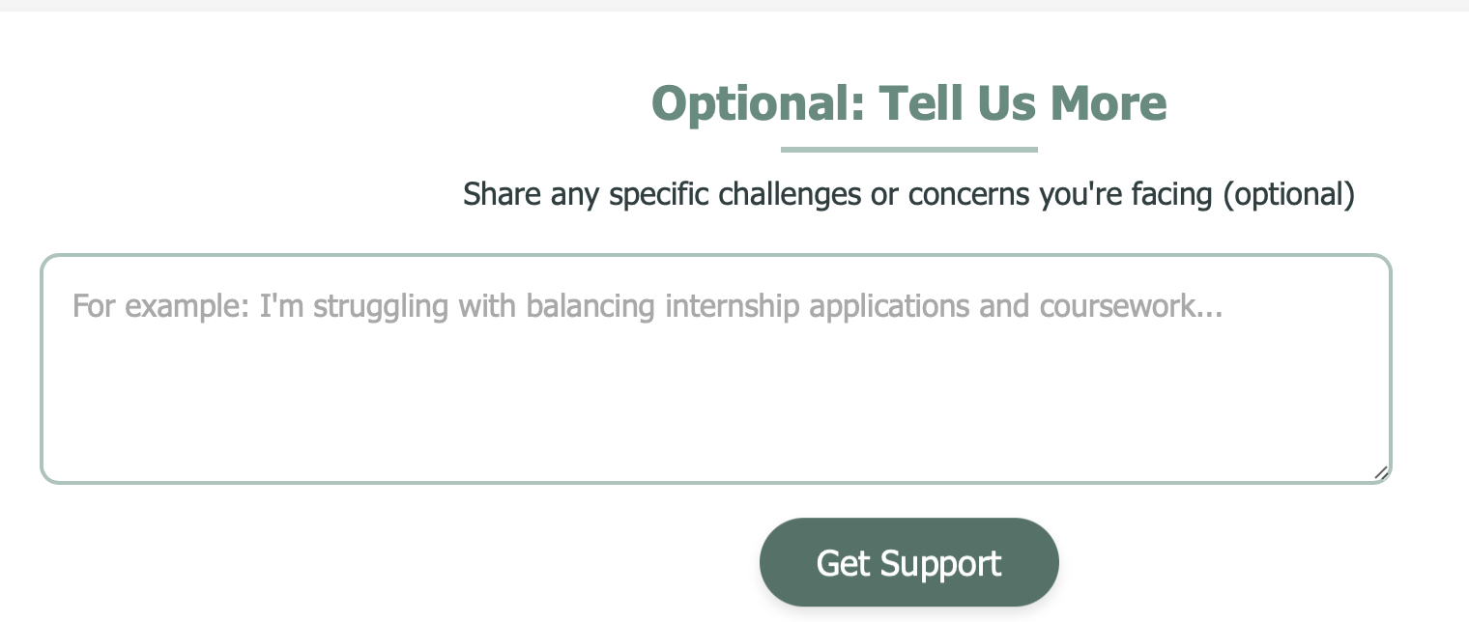
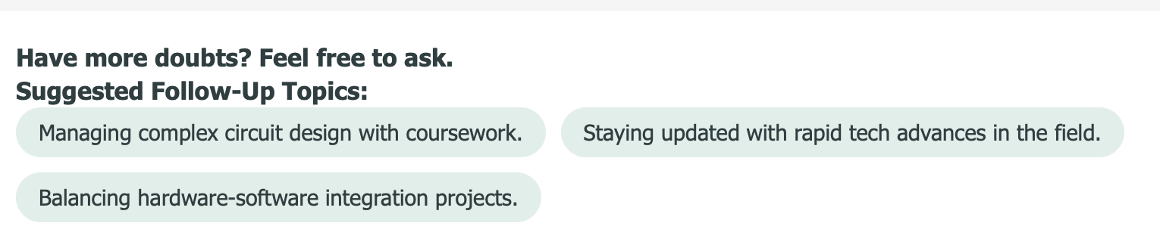
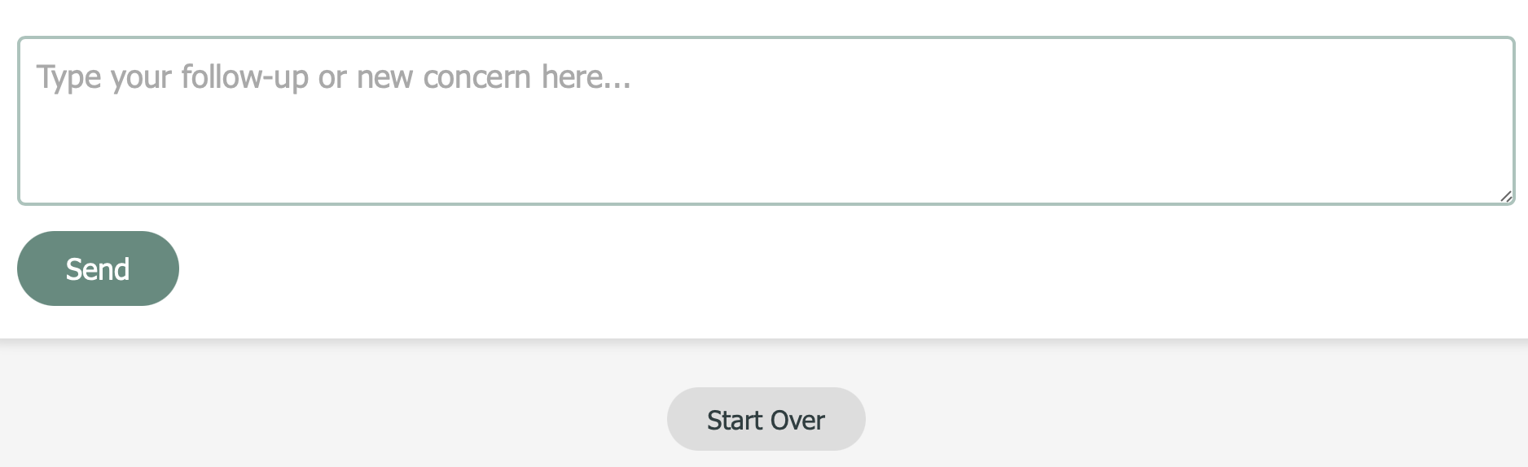
Key UI Features
Step-by-Step Questionnaire: Students select their major, academic year, and optionally add any specific concerns.
Dynamic Suggestions: The bot tailors follow-up topics based on the chosen major.
Chat Interface: Users can submit additional questions in a real-time chat format, simulating a conversational counseling session.
Start Over Button: Quickly begin a new session to explore different concerns.

Slide 6
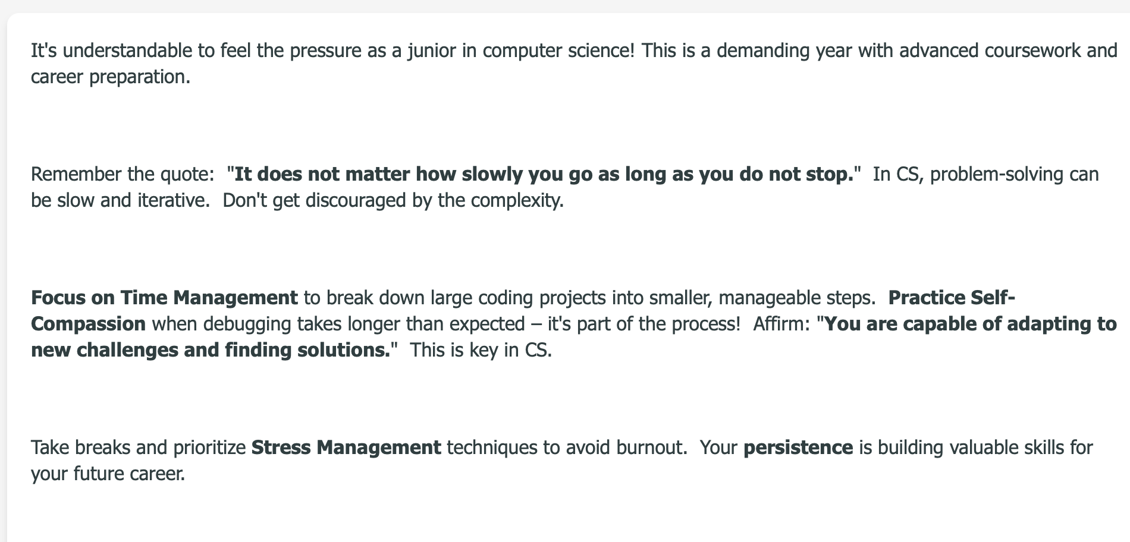
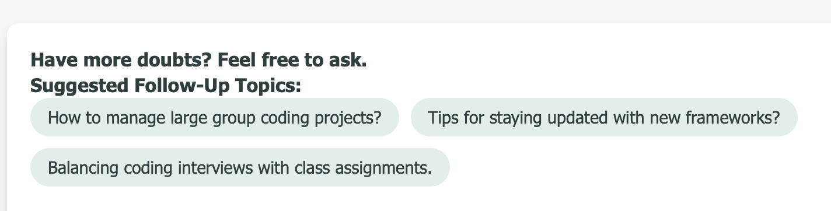
Example Outputs
Personalized Burnout Tips:
“This is a demanding year with advanced coursework and career preparation.”
Emphasizes time management, self-compassion, and stress-busting routines.
Follow-Up Topics:
E.g., “Balancing coding interviews with class assignments,” or “How to manage large group coding projects?”
Actionable Advice Snippets:
Short, encouraging messages such as “Take breaks and prioritize Stress Management” or “persistence is building valuable skills for your future career.”

Slide 7


Wrap-Up & What can we do Next?
The Burnout & Overwhelm Support Bot provides quick, empathetic academic stress support.
User-friendly interface guides students through tailored advice based on major and year.
This bot demonstrates how AI can offer accessible well-being support, complementing on-campus mental health services.
Future Improvements: Expand content for more majors, integrate self-assessment surveys, and offer links to professional resources.

